Slide 1
2022-23 BUDGET HEARING
May 3, 2022

Slide 2
Agenda
Review Proposed 2022-23 Budget
Enrollment, Attrition & Staffing
Budget Overview and Comparisons
Revenue Budget
Proposed Capital Reserve
Looking to the Future
Reserves
Debt Service
Tax Cap implications
Contingent Budget
Budget Questions

Slide 3
Review: Proposed 2022-23 Budget
Keys to this budget
Enrollment
Attrition
Small increase in taxes to offset negative tax cap last year
New Capital Reserve
Planning for the future
Notes:
Bob will talk about dollars and reserves later
I’m going to try to frame the issues that shaped this year’s budget proposal
In looking at this year’s budget, we really need to look 1-3/4-6 years out – decisions made this year will impact what the district can do four years from now
For example, we are trying to anticipate what happens once the Foundation Aid formula is fully funded in 24-25 and ‘25-’26, as promised by the governor
The history of school funding formulas and the legal challenges that have been raised over the years is long, but the short version is this: equal to equitable to adequacy (per pupil allocations [like our textbook aid] to weighted aid to account for poverty/district wealth to “is state aid sufficient to provide an “adequate” education for all students”). The Foundation Aid Formula is old, and problematic, but fully funding it will resolve the Campaign for Fiscal Equity lawsuit settlement.
With the Foundation Aid fully funded next year, what can we expect for state aid? Cost of living? State solvency issues? Statewide loss of residents/ drop in state revenue?
Tax cap – could have a negative tax cap again next year or the year after (loss of building aid, transportation aid [fewer kids, less mileage, less aid])
We are trying to take advantage of the drop in enrollment and attrition to buffer some of these future threats..
% budget increase = 1.90% or $680K
Property tax cap @ 2% = $400K ---- you’ll see why this is important in a few minutes, when Bob addresses the budget numbers specifically

Slide 4
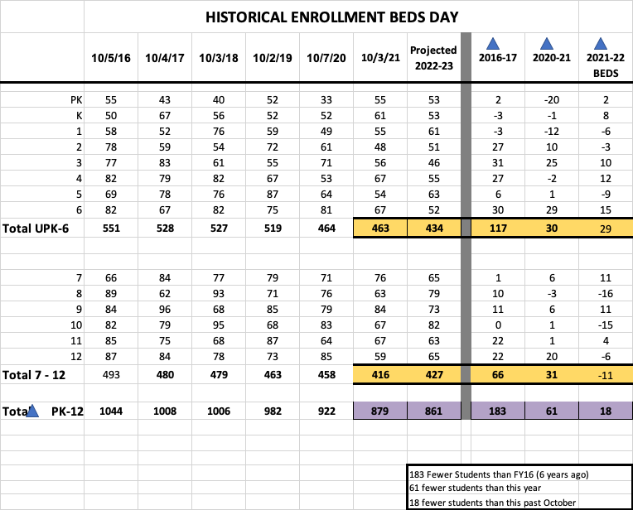
Notes:
Negatives are gains/positives are losses

Slide 5
The important part...
ES
Notes:
ES enrollment has dropped by 117 students in the past 6 years – a 21% drop
SS = -66 / -31 / +11 Net gain for the SS this year

Slide 6
Attrition
With retirements, non-renewals and other resignations, we have these position vacancies:
19-20 vacant positions ---- reduce 6, keep 14
2-3 Aides 2 Elementary Classroom 4 Special Education 1 Guidance Counselor 1 AIS | 2 Math 1 Tech Ed 1 Health PE 2 Social Workers 1 School Nurse 2 Secretaries

Slide 7
Attrition
Reduce
2 Elementary Classroom
1 Elementary Sp Ed
1 Elementary Social Worker
1 Elementary AIS
1 Guidance Secretary
Keep
2 Math
3 Sp Ed
1 Social Worker
1 Tech Ed
1 Guidance Secretary
1 Guidance Counselor
1 Health/PE
1 Nurse
2-3 Aides

Slide 8
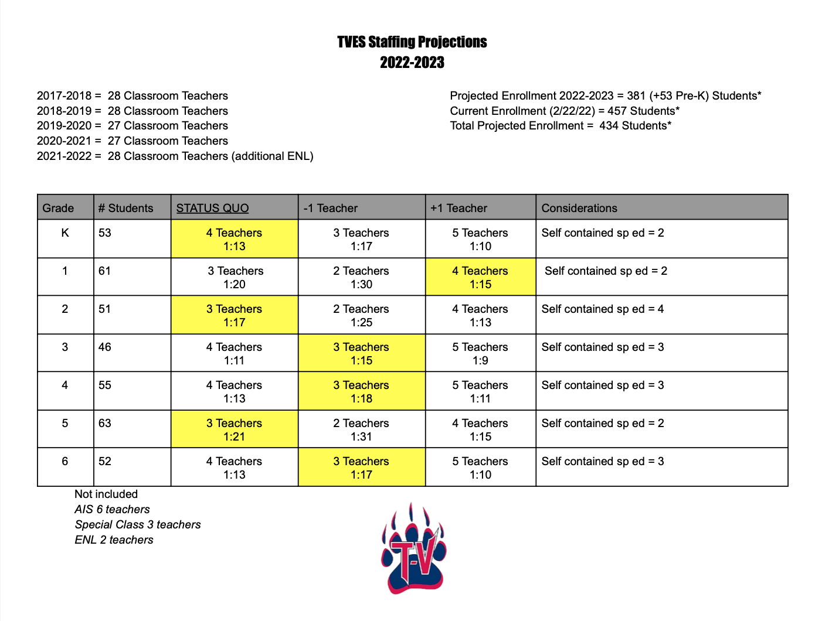

Slide 9
Budget Overview and Comparison
 |  |  |  |  |  |  |  |  |  |  | 3/31/2022
 |  | 2020-21 | Pct | Pct of |  | 2021-22 | Pct | Pct of |  | 2022-23 | Pct | Pct of
 |  | Adopted | Change | Budget |  | Adopted | Change | Budget |  | Proposed | Change | Budget
Administrative |  | $3,320,022 | 1.30% | 9.52% |  | $3,457,292 | 4.12% | 9.83% |  | $3,585,024 | 3.69% | 9.88%
Capital |  | $4,259,374 | -3.76% | 12.21% |  | $4,374,844 | 2.71% | 12.44% |  | $4,361,583 | -0.30% | 12.07%
Program |  | $27,290,681 | 0.46% | 78.26% |  | $27,339,127 | 0.18% | 77.73% |  | $27,892,764 | 2.03% | 78.05%
TOTAL |  | $34,870,077 | 0.00% | 100% |  | $35,171,263 | 0.86% | 100% |  | $35,839,371 | 1.90% | 100%

Slide 10
Revenue and Comparison
2022-23 BUDGET |  | REVENUE
 |  |  |  |  |  | 3/31/2022
2021-22 REVENUE PROJECTIONS
 |  | 2020-21 |  | 2021-22
REAL PROPERTY TAXES (RPT) |  | $21,154,821 | 0% | $20,986,560 | -0.80% | $21,154,821 | 0.80%
PILOTS |  | $102,000 |  | $106,000 |  | $106,000
INTEREST & PENALTIES |  | $11,500 |  | $22,500 |  | $17,500
ADMISSIONS |  | $100 |  | $100 |  | $100
OTHER CHARGES |  | $0 |  | $0 |  | $0
DAY SCHOOL TUITION |  | $92,000 |  | $92,000 |  | $58,000
INTEREST & EARNINGS |  | $80,000 |  | $100,000 |  | $80,000
COMMISSIONS |  | $250 |  | $250 |  | $100
INSURANCE RECOVERIES |  | $500 |  | $250 |  | $250
OTHER COMPENSATION FOR LOSS |  | $750 |  | $500 |  | $500
BOCES REFUND |  | $265,000 |  | $325,000 |  | $325,000
MEDICAID ASSISTANCE |  | $25,000 |  | $37,500 |  | $37,500
OTHER REVENUE |  | $577,100 |  | $684,100 |  | $624,950
STATE AID |  | $11,406,168 |  | $11,991,520 |  | $12,667,601
APPLIED FUND BALANCE |  | $1,731,988 |  | $1,509,083 |  | $1,509,083
APPLIED RESERVE BALANCE
BUDGET |  | $34,870,077 | 0% | $35,171,263 | 0.86% | $35,839,371 | 1.90%

Slide 11
Program Budget Overview and Comparison
Increase of $668,108 (1.90%)
Reinstated Sup & Mat purchasing to pre-pandemic levels
Additional $400,000 in off campus Special Education costs
Portion of new Speech position (phasing in with use of ARP funds)
ARP funds will be used for non-school day runs to offset high CPI
21-22 staff recruiting required higher salaries to attract hires; 22-23 estimates for new hires have been adjusted

Slide 12
Capital Budget Overview and Comparison
Decrease of $13,261 (-0.30%)
Additional Expenses to address some water system needs
End of life for Maintenance Vehicle(s), time to replace
EPC project electric savings
Fuel Bid yet to be conducted
Decrease in Debt Service based on 21-22 budget conservative estimate for new bond

Slide 13
Administrative Budget Overview & Comparison
Increase of $127,732 (3.69%)
Confidential/Management employees projected salary increases
Year 1 of leasing new copiers districtwide
Add 1.0 FTE in Admin Office
Addressing Administrative clerical needs to meet additional work loads

Slide 14
New Capital Project Reserve
RESOLVED that the Board of Education approves the following proposition and
directs that it be placed before the voters at the May 17, 2022 District meeting:
Shall the Board of Education be authorized to establish a capital reserve fund, designated as the 2022 Capital Reserve Fund, in accordance with Education Law § 3651(1), for the purpose of paying the cost of future building projects and facility renovations, in a maximum amount not to exceed $20,000,000, plus accrued earnings, to be raised by annual transfers of unappropriated fund balances, annual transfers of excess funds from the general fund in an amount up to $750,000, for a probable term of ten (10) years, effective July 1, 2022 and expiring June 30, 2032, provided that, pursuant to Education Law § 3651(3), no expenditure shall be made from such fund except upon authorization of the voters of the District for the purposes specified herein?

Slide 15
Debt/Building Aid/Tax Cap/Budget Forecasting
 | 2020-21 | 2021-22 | 2022-23 | 2023-24 | 2024-25 | 2025-26
Building Aid | $824,434 | $1,326,571 | $1,075,305 | $567,908 | $565,215 | $562,769
Debt | $1,216,050 | $1,269,700 | $1,273,050 | $362,250 | $359,250 | $356,250
 | debt difference yr to yr | $53,650 | $3,350 | -$910,800 | -$3,000 | -$3,000
bldg aid vs debt | -$391,616 | $56,871 | -$197,745 | $205,658 | $205,965 | $206,519
Tax Cap | 2.08% | -0.80% | 3.57% | -3.15%% | -3.15% | -3.18%
 | $439,727 | -$168,261 | $748,729 | -$666,377 | -$645,386 | -$625,056
Tax Levy | 21,154,821 | 20,986,560 | 21,154,821 | 20,488,444 | 19,843,058 | 19,218,002

Slide 16
Potential Effect on Budget
Debt Service Reduction in Budget $ -910,800
Negative Tax Cap $ -666,377
Total $-1,577,177
This represents a potential 4.40% cut in overall Budget for 2023-24
Majority of these cuts would be in Staffing
The proposed up to $750,000 interfund transfer to the Capital Fund is planned to reduce the effect of the Debt Service expense in the General Fund Budget.

Slide 17
Use of Reserves for next year’s Budget
In accordance with NYS Education Law and General Municipal Law, we have two reserves (Workers Compensation and Unemployment) where any or all of funds can be applied to next year’s budget. Looking one year in the future, approximately $350,000 to $400,000 could be applied.
Summarizing, the proposed 2022 Capital Reserve Fund, in conjunction, with the use of designated reserve funds should enable the district be prepared to maintain all current programs while developing the 2023-24 Budget.

Slide 18
Contingency Budget
2022-23 Budget - Contingency Cap Worksheet
3/31/2022
 | 2021-22 | 2022-23 | Mandated | 2022-23 |  | 2022-23
 | Adopted | Proposed | Deducts | Contingent Budget | Adjustments | Contingent Budget
 | Budget | Budget |  | Before Percentage |  | After Percentage
 |  |  |  | Adjustments |  | Adjustments
Admin. Component | $3,457,292 | $3,585,024 | $25,200 | $3,559,824 | $0 | $3,559,824
Program Component | $27,339,127 | $27,892,764 | $199,950 | $27,692,814 | $0 | $27,692,814
Capital Component | $4,374,844 | $4,361,583 | $79,500 | $4,282,083 | $0 | $4,282,083
Total | $35,171,263 | $35,839,371 | $304,650 | $35,534,721 | $0 | $35,534,721
Admin % = | $3,457,292 | $3,585,024 |  | $3,559,824 |  | $3,559,824
 | $30,796,419 | $31,477,788 |  | $31,252,638 |  | $31,252,638
 | 11.2263% | 11.3891% |  | 11.3905% |  | 11.3905%
Effective Cap % = | 11.3905%
Property Tax Maximum = | $20,986,950 |  | Proposed Budget Increase = $35,839,371 - $35,171,263 = $668,108 = 1.90%
 |  |  | Contingency Budget Increase = $35,534,721 - $35,171,263= $363,458 = 1.03%

Slide 19
Questions?

